Slide 1

CM20315 - Machine Learning
Prof. Simon Prince
5a. Catchup

Slide 2
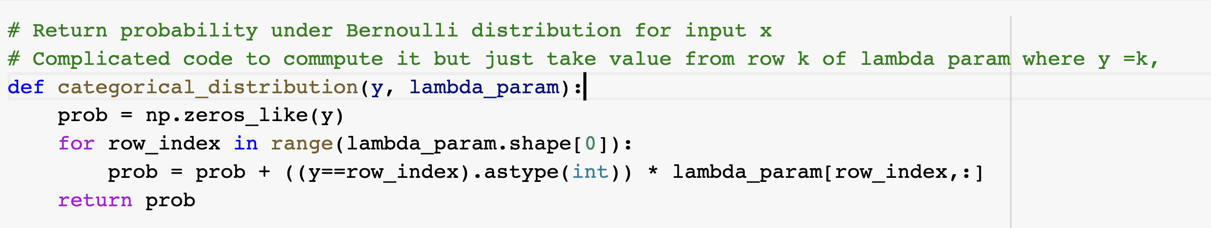
Mysterious code

Slide 3
Mysterious code

Slide 4
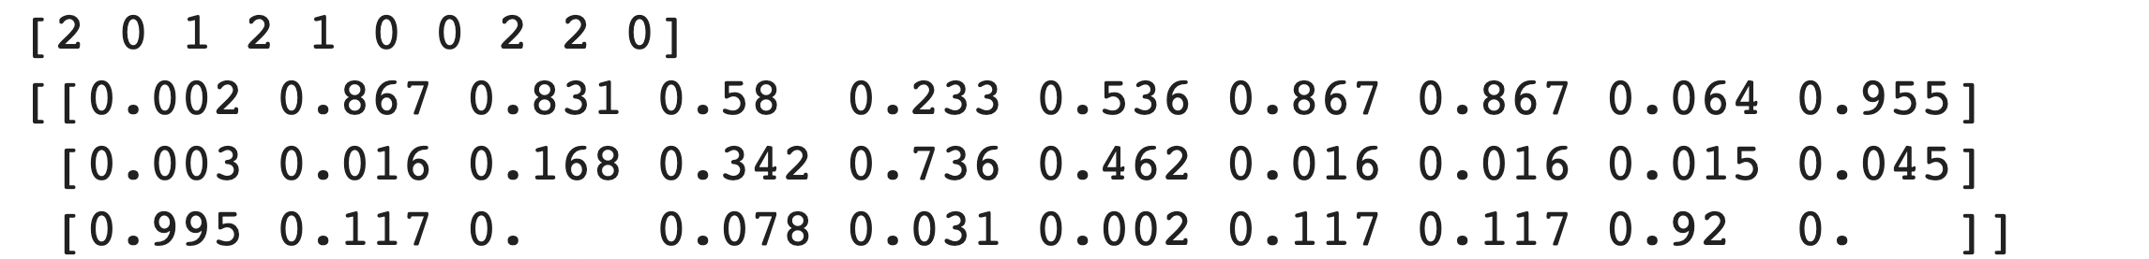
Mysterious code

Slide 5
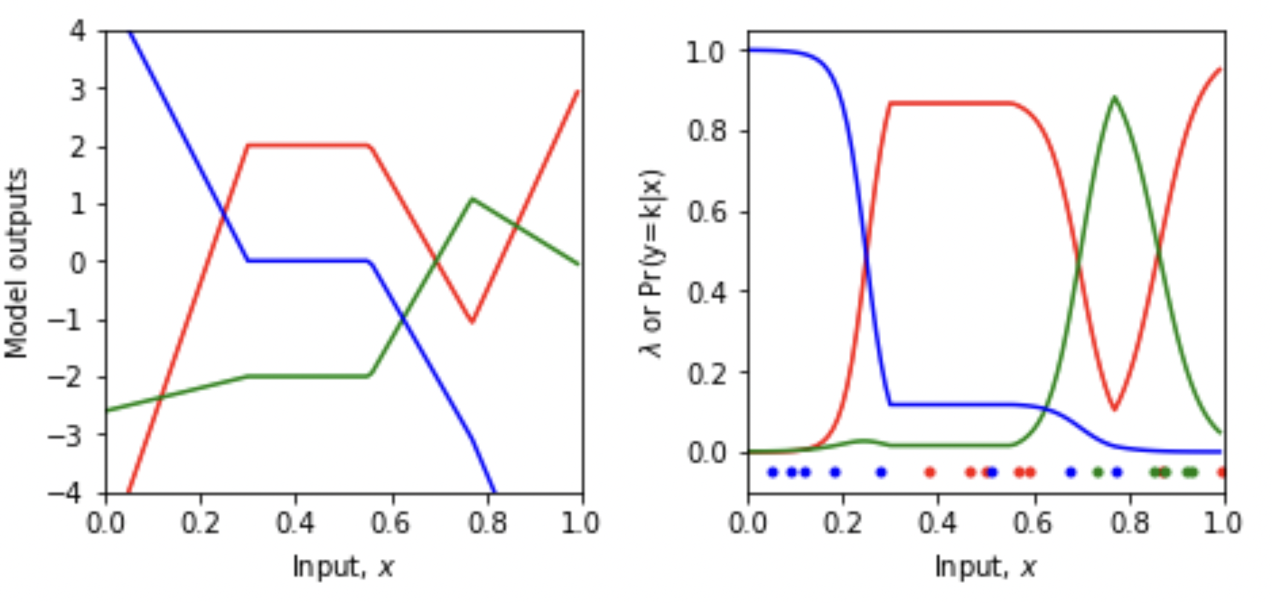

Slide 6
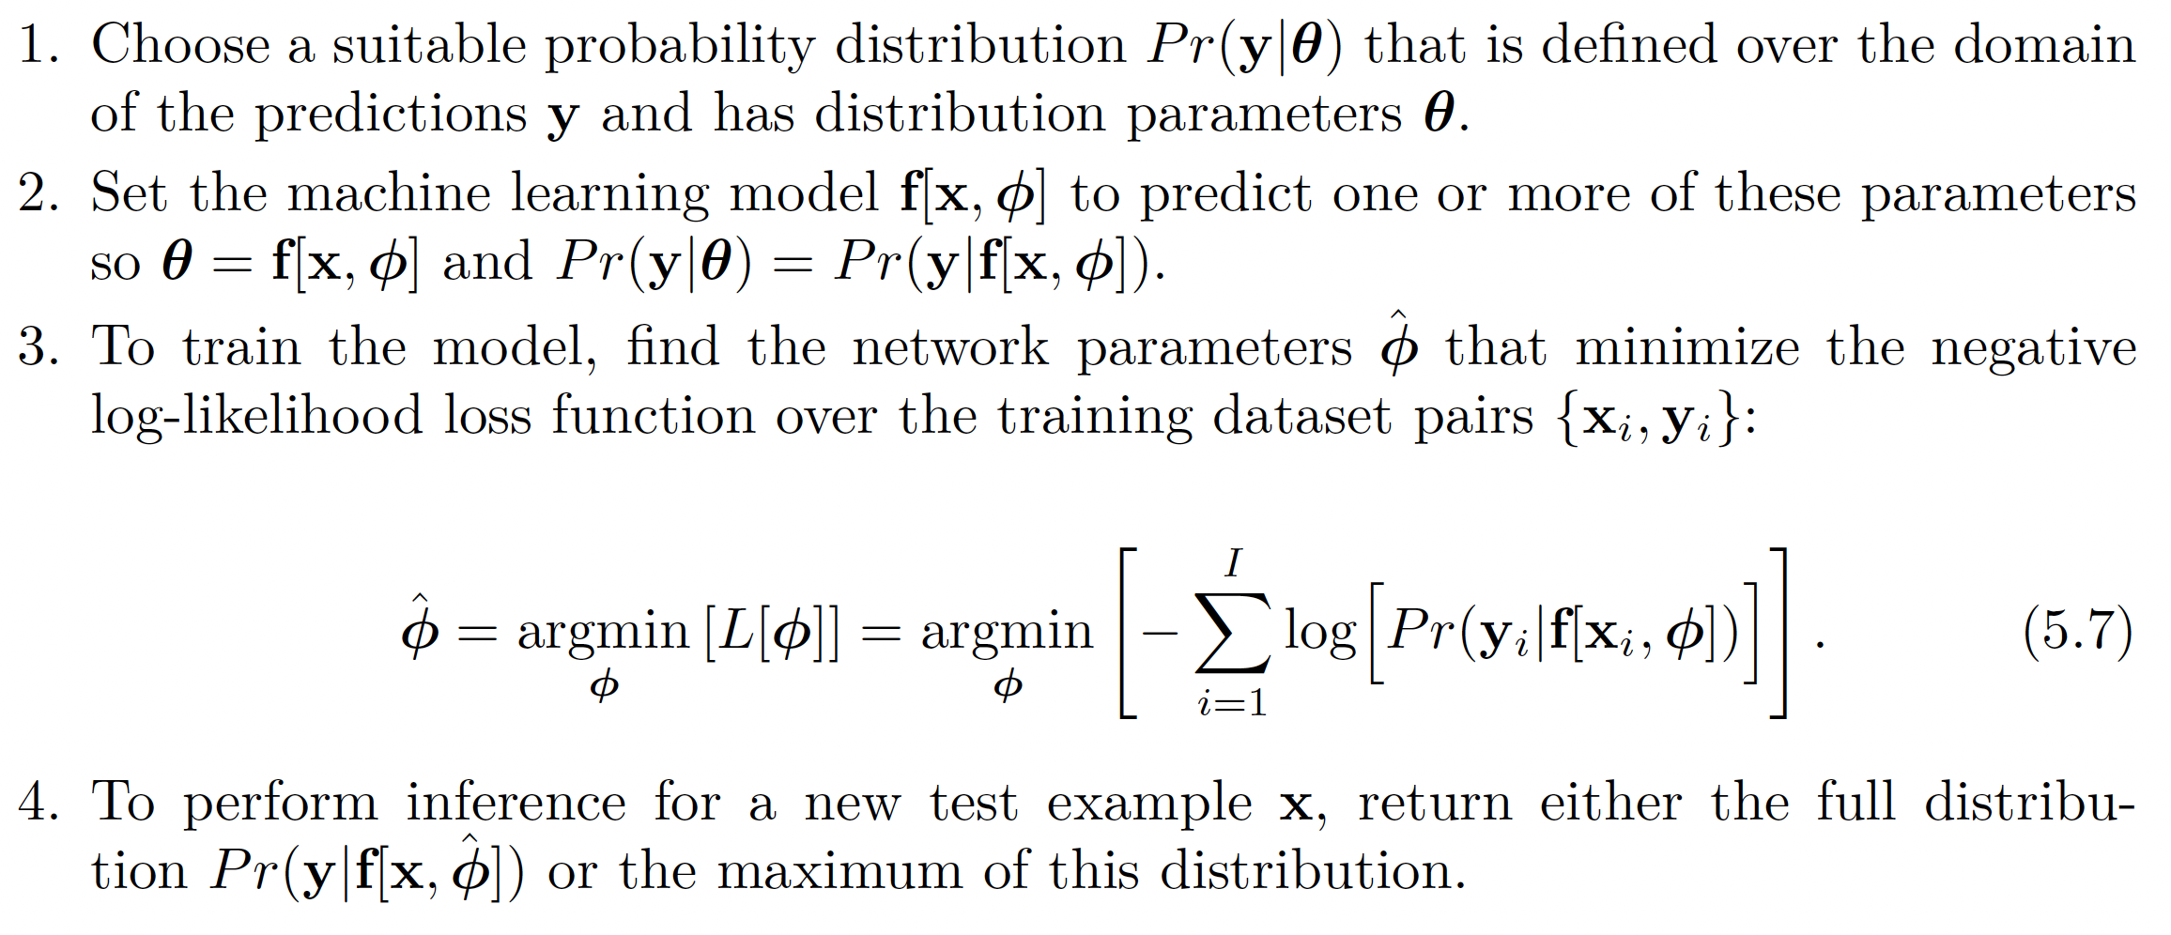
Recipe for loss functions

Slide 8

Recipe for loss functions

Slide 9
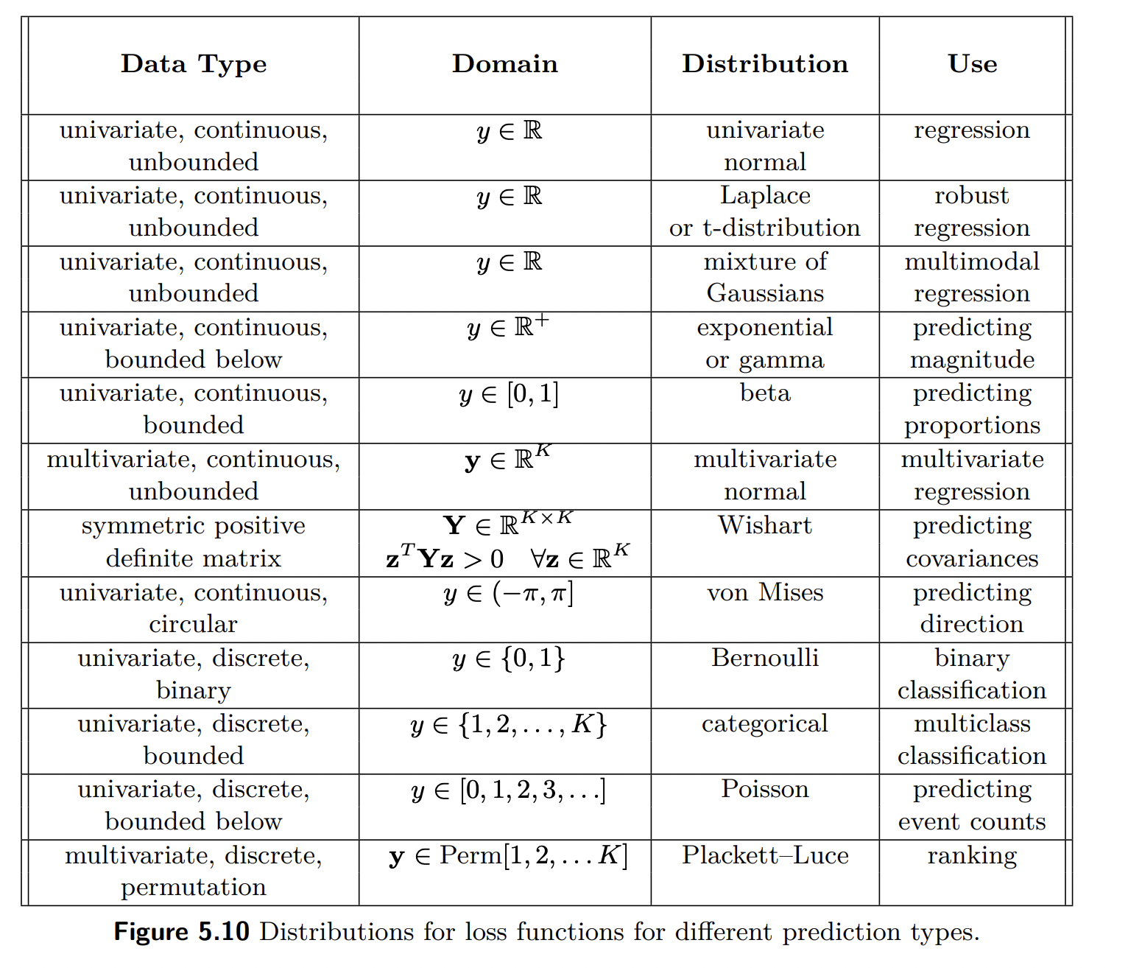

Slide 10
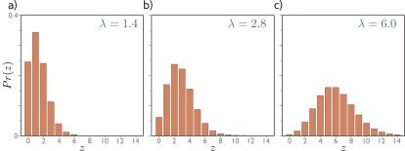
Poisson distribution

Slide 11

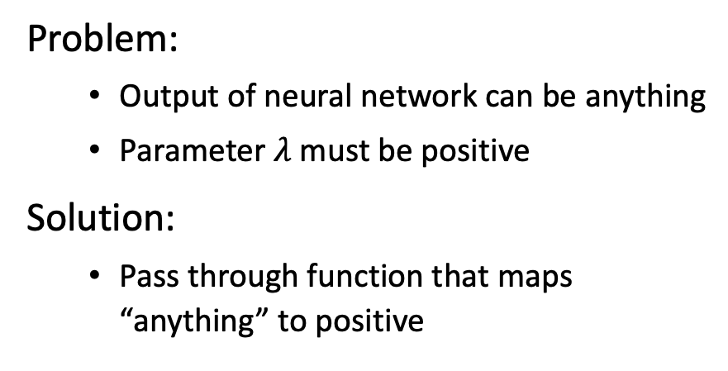
Problem:
Output of neural network can be anything
Parameter $λ$must be positive
Solution:
Pass through function that maps “anything” to positive

Slide 12
Problem:
Output of neural network can be anything
Parameter $λ$must be positive
Solution:
Pass through function that maps “anything” to positive

Slide 17
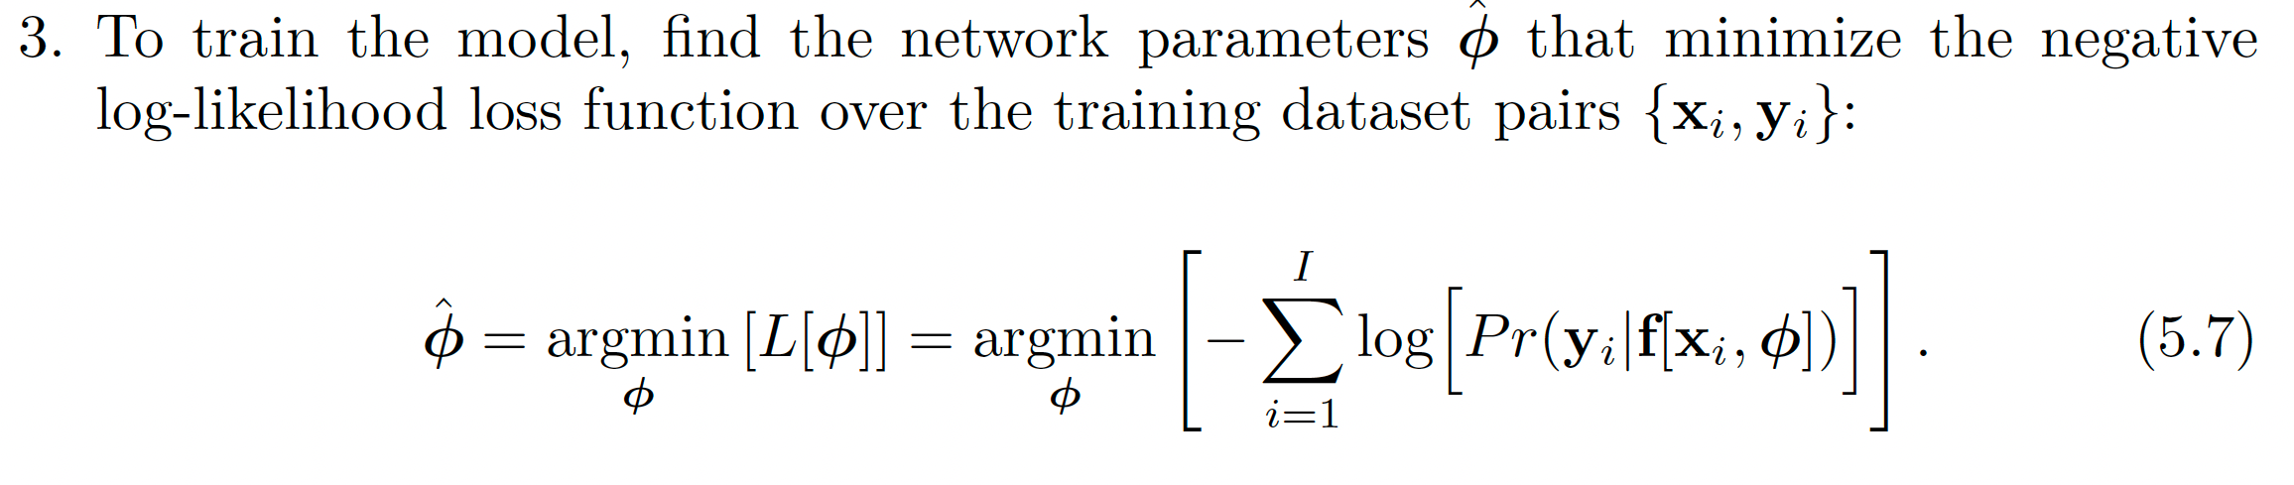

Slide 21


Slide 22
Recipe for loss functions

Slide 24
Recipe for loss functions

Slide 26
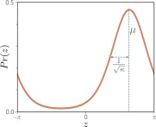
Von Mises distribution

Slide 31
Model
Parameters:
Model :
Parameters always Greek letters

Slide 32
Loss function
Training dataset of I pairs of input/output examples:
Loss function or cost function measures how bad model is:
or for short:
Returns a scalar that is smaller when model maps inputs to outputs better

Slide 33
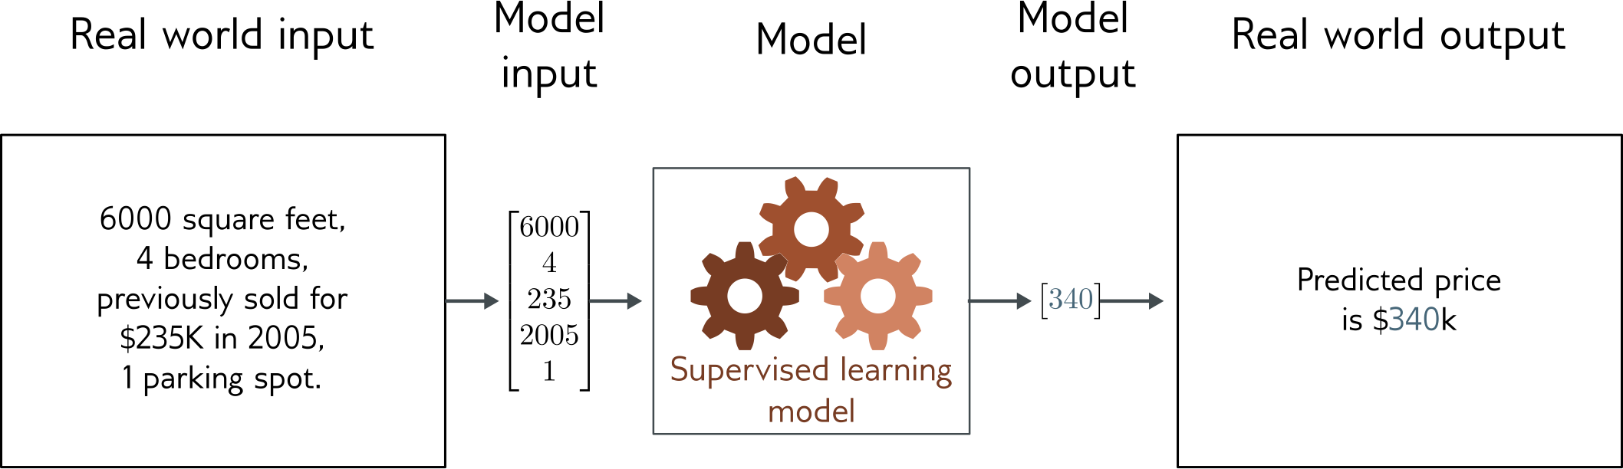
Regression
Univariate regression problem (one output, real value)
Fully connected network

Slide 34
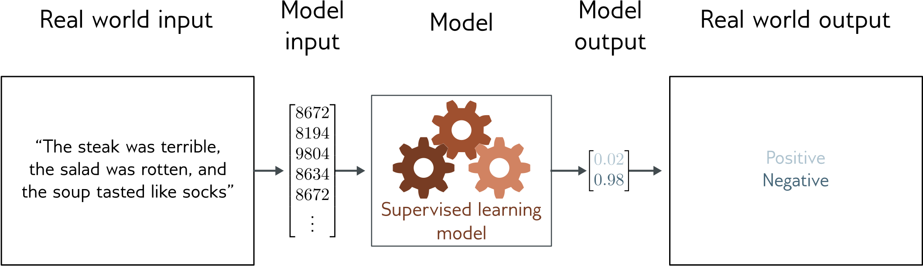
Text classification
Binary classification problem (two discrete classes)
Transformer network

Slide 35
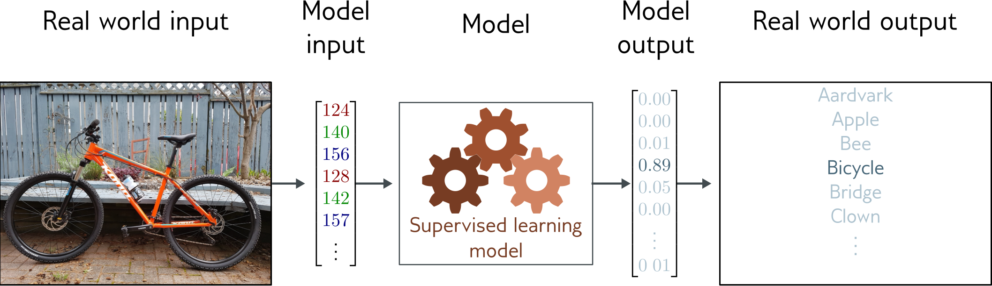
Image classification
Multiclass classification problem (discrete classes, >2 possible classes)
Convolutional network

Slide 36
Depth estimation
Multivariate regression problem (many outputs, continuous)
Convolutional encoder-decoder network

Slide 37
Image segmentation
Multivariate binary classification problem (many outputs, two discrete classes)
Convolutional encoder-decoder network

Slide 38
Entity classification
Multivariate multiclass classification
Transformer network

Slide 39
Translation

Slide 40
Training
Loss function:
Find the parameters that minimize the loss:
Returns a scalar that is smaller when model maps inputs to outputs better

Slide 41
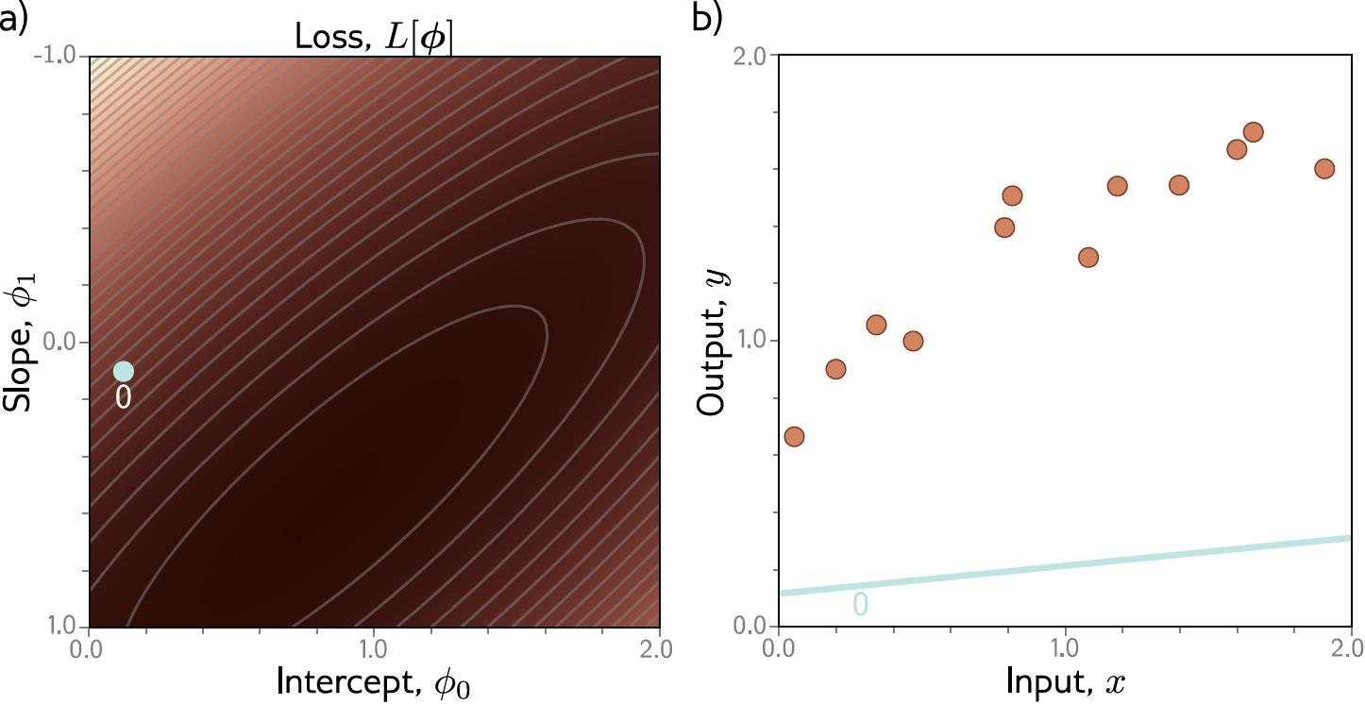
Example: 1D Linear regression training

Slide 42
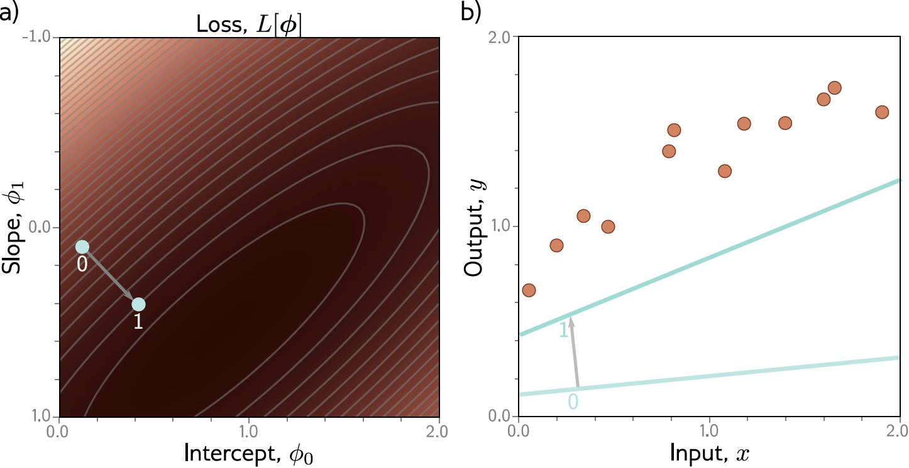
Example: 1D Linear regression training

Slide 43
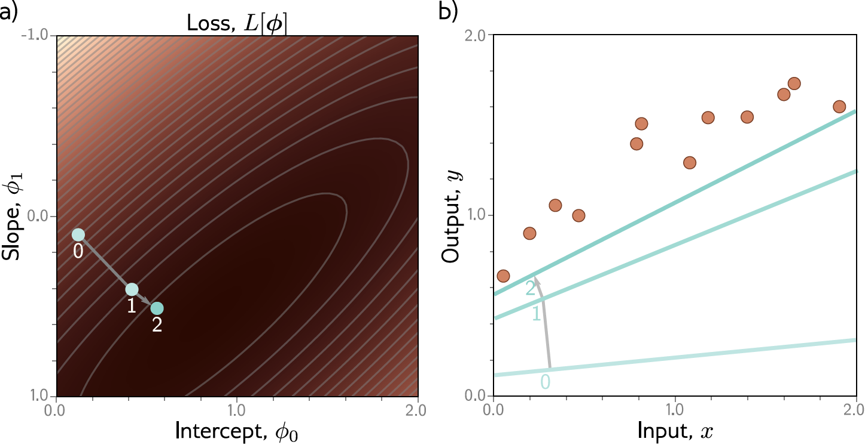
Example: 1D Linear regression training

Slide 44

Example: 1D Linear regression training

Slide 45
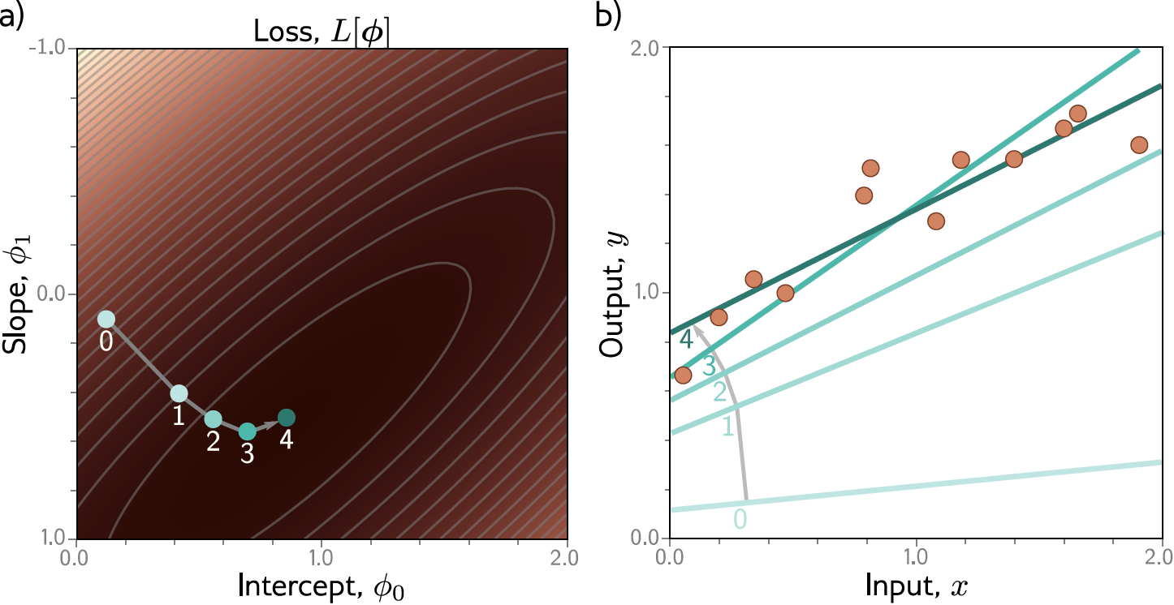
Example: 1D Linear regression training
This technique is known as gradient descent

Slide 46
